Slide 1



Object-Oriented Programming with C#
Classes, Constructors, Properties, Static Members, Interfaces, Inheritance, Polymorphism

Slide 2
Base keyword
Is used to access members of base class from derived class
Base. Will display all members of base class

Slide 3
New Keyword
The new keyword is used to explicitly hide a member inherited from base class.
The new modifier is used to indicate that a derived class member is a new member.
Also known as method hiding.
See the example

Slide 4
What is Polymorphism ?
Polymorphism means one name many forms
One function behaves in different forms.
"Many forms of a single object is called Polymorphism.”

Slide 5
Real World Example of Polymorphism
Example 1
A Teacher behaves with student.
A Teacher behaves with his/her seniors.
Here teacher is an object but the attitude is different in different situations.
Example 2
Person behaves as a SON in house, at the same time that person behaves like an EMPLOYEE in the office.

Slide 6
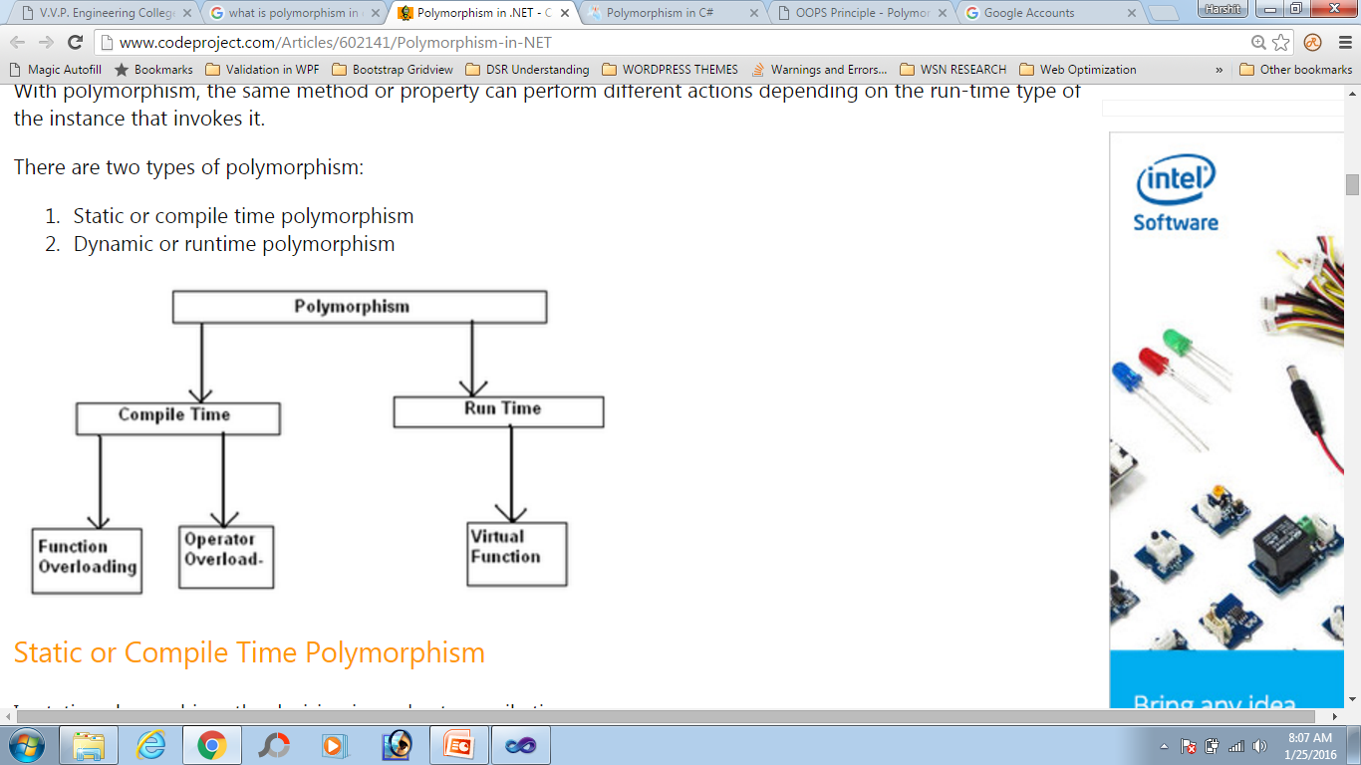
Types of polymorphism:

Slide 7
Static Polymorphism
Method overloading is an example of this.
the decision is made at compile time
Which method is to be called is decided at compile-time only.

Slide 8
Method Overloading
Method overloading is a concept where a class can have more than one method with the same name and different parameters.
the compiler knows which overloaded method it is going to call.
Compiler checks the type and number of parameters passed on to the method and decides which method to call at compile time

Slide 9
Method Overriding
Run-time polymorphism is achieved by method overriding
Creating a method in derived class with same signature as a method in base class is called as method overriding.
When derived class needs a method with same signature as in base class, but wants to execute different code than provided by base class then method overriding will be used.

Slide 10
How ?
To allow the derived class to override a method of the base class, C# provides two options,
virtual methods and abstract methods.
Through the reference variable of a base class, the determination of the method to be called is based on the object being referred to by reference variable.

Slide 11
Virtual Methods
Virtual method is a method whose behavior can be overridden in derived class.
Virtual method allows declare a method in base class that can be redefined in each derived class
Override keyword is used in derived class to override virtual method.
Example of late binding

Slide 12
Abstract modifier
When abstract modifier is used with class, object cannot be created for this class.
Abstract modifier in method is used to indicate the method is implemented in a derived class.
You can force a class to override a method by declaring the base class’s method as abstract.

Slide 13
The abstract method declaration cannot be used in combination with virtual. This is because an abstract method is implicitly virtual.
Abstract method declarations are permitted only in abstract classes.

Slide 14

Abstract Classes
Abstract method is a method without implementation
Left empty to be implemented by descendant classes
When a class contains at least one abstract method, it is called abstract class
Mix between class and interface
Inheritors are obligated to implement their abstract methods
Can not be directly instantiated

Slide 15
Abstract Class – Example
abstract class MovableShape : IShape, IMovable
{
private int x, y;
public void Move(int deltaX, int deltaY)
{
this.x += deltaX;
this.y += deltaY;
}
public void SetPosition(int x, int y)
{
this.x = x;
this.y = y;
}
public abstract int CalculateSurface();
}

Slide 16
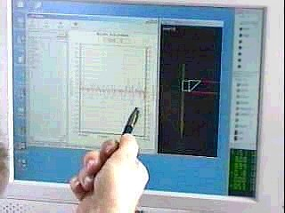
Interfaces and Abstract Classes

Slide 17
Interface
Interface is a reference type that contains only abstract members
It can contain events, methods, properties and indexers
It can contain only the declaration of members.
Implementation of these members must be present in the classes that implement the interface.

Slide 18
One abstract class
public abstract class cShape
{
public abstract long area();
public abstract long circum();
public abstract int sides();
}
A class that is derived from above class will implement all the above mentioned methods.

Slide 19
Interface
public interface iShape
{
long area();
long circum();
int sides();
}
iShape and Cshape both are similar. Any class which implements iShape has to implement all the three methods.

Slide 20
Differs from class ?
An interface dose not specify implementation of methods. It just provides the idea that what the implementing class does.
All members of an interface are ‘public’ by default. If we try to specify any other access modifier , compiler will give error.
Interface can only contain – methods, properties, events, indexers
Does not contain –Constant, fields, constructors, destructor, static members

Slide 21
Advantages:
A class can be derived from multiple interfaces.
A structure can be derived from interfaces.

Slide 22
Defining Interface :
Interface Iname
{
Members ;
}
Here bodies of methods are not specified with interface

Slide 23
Pure abstract classes ( contains all abstract methods) and interfaces have similarity.
A pure abstract class is guideline which indicates that what the child classes must do.
Interfaces support above features in addition they support multiple inheritance.

Slide 24
Interfaces- Note down
Describe a group of methods (operations), properties and events
Can be implemented by given class or structure
Define only the methods’ prototypes
No concrete implementation
Can be used to define abstract data types
Can not be instantiated
Members do not have scope modifier and by default the scope is public

Slide 25

Interfaces – Example
public interface IPerson
{
string Name // property Name
{ get; set; }
DateTime DateOfBirth // property DateOfBirth
{ get; set; }
int Age // property Age (read-only)
{ get; }
}

Slide 26
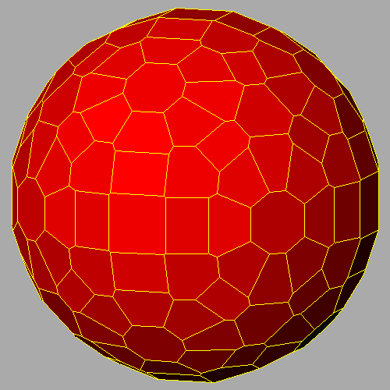
Interfaces – Example (2)
interface IShape
{
void SetPosition(int x, int y);
int CalculateSurface();
}
interface IMovable
{
void Move(int deltaX, int deltaY);
}
interface IResizable
{
void Resize(int weight);
void Resize(int weightX, int weightY);
void ResizeByX(int weightX);
void ResizeByY(int weightY);
}

Slide 27
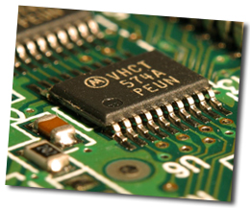
Interface Implementation
Classes and structures can implement (support) one or many interfaces
Interface realization must implement all its methods
If some methods do not have implementation the class or structure have to be declared as an abstract

Slide 28
Interface Implementation – Example
class Rectangle : IShape, IMovable
{
private int x, y, width, height;
public void SetPosition(int x, int y) // IShape
{
this.x = x;
this.y = y;
}
public int CalculateSurface() // IShape
{
return this.width * this.height;
}
public void Move(int deltaX, int deltaY) // IMovable
{
this.x += deltaX;
this.y += deltaY;
}
}

Slide 29

Structures

Slide 30
Structures
Structures represent a combination of fields with data
Look like the classes, but are value types
Their content is stored in the stack
Destroyed when go out of scope
However classes are reference type and are placed in the dynamic memory (heap)
Their creation and destruction is slower

Slide 31
Use of class/objects is desirable when the size of the data members is very large.
This is because when an object is passed to a function only its reference is copied to the function and reference is of few bytes.
Use of class/objects is undesirable when the total size of data members is very small( say 16 bytes or less). This is because the size of reference is same as that of data members.

Slide 32
Structures can implement constructors, constants, fields, methods, properties, indexers, operators and nested types.
Structure do not support inheritance.
Structures can neither inherit nor be inherited from.
However they can implement interfaces.

Slide 33
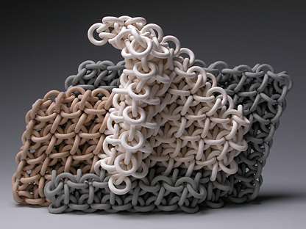
Structures – Example
struct Point
{
public int X, Y;
}
struct Color
{
public byte redValue;
public byte greenValue;
public byte blueValue;
}
struct Square
{
public Point location;
public int size;
public Color borderColor;
public Color surfaceColor;
}

Slide 34
example
Class class1
{
static void Main()
{
Point p1= new Point();
p1.x= 20;
p1.y=30;
Console.WriteLine(p1.x);
Console.WriteLine(p1.y);
}
}

Slide 35
Here new Point() calls the default constructor supplied by compiler. The constructor initialized all the fields of struct.
If new Point() is removed, above listing will work..
But if p1.x=20 and p1.y=30 is removed,
Above listing will not work as p1.x and p1.y are unassigned.

Slide 36
Nested Structures
Struct line
{
public struct Point
{
public int x,y;
}
}

Slide 37
Nested Structures
Class ex
{
static void Main()
{
line l1= new line();
line.Point p1= new line.Point();
Console.WriteLine(“{0} {1}”,p1.x, p1.y);
p1.x= 10; p1.y= 20;
Console.WriteLine(“{0} {1}”,p1.x, p1.y);
}
}
//we can not write l1.p1.x

Slide 38
One can not specify an explicit no parameter constructor in a struct. If specified, compilers gives error.
Struct Point
{
public int x,y;
/* public Point()
{
}/* wrong
public Point(int x1, int y1)
{
x=x1; y=y1;
}
}

Slide 39
When to Use Structures?
Use structures
To make your type behave as a primitive type
If you create many instances and after that you free them – e.g. in a cycle
Do not use structures
When you often transmit your instances as method parameters

Slide 40
Operator Overloading

Slide 41
What is Operator Overloading?
You can redefine or overload most of the built-in operators available in C#
Thus a programmer can use operators with user-defined types as well
Overloaded operators are functions with special names the keyword operator followed by the symbol for the operator being defined
similar to any other function, an overloaded operator has a return type and a parameter list

Slide 42
Example
Public static Box operator+ (Box b, Box c)
{
Box box = new Box();
box.length= b.length + c.length;
box.breadth = b.breadth + c.breadth;
box.height = b.height + c.height;
return box;
}

Slide 43
The above function implements the addition operator (+) for a user-defined class Box.
It adds the attributes of two Box objects and returns the resultant Box object.

Slide 44
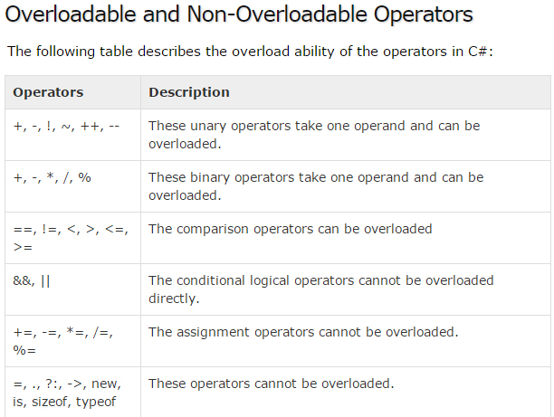
Which operators can be overloaded ?

Slide 45

Object-Oriented Programming with C#
Questions?
?
?
?
?

